Slide 1

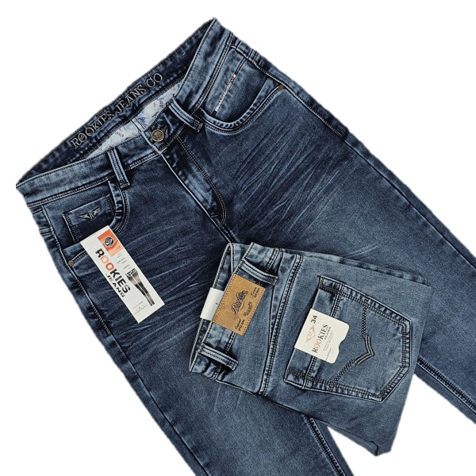


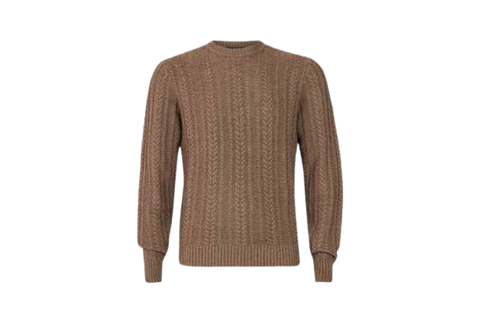
KNIT
WOVEN
SWEATER
From knit to woven to sweater, we master every material. Your complete collection for contemporary style, built on quality assurance

Slide 2



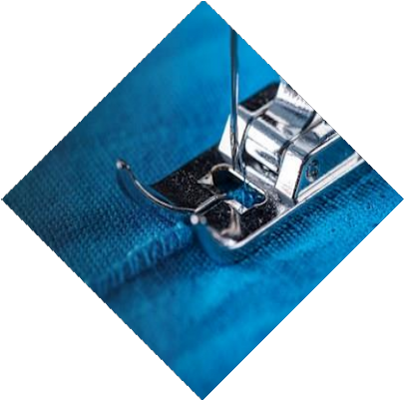





Company Profile
7
Best Quality
Best Goods
W e c a n d o i t
We started as a small garment manufacturing unit in Gazipur, the industrial part of Dhaka in 2020. Fardar Fashions has been engaged in manufacturing & exporting
SUBSCRIBE AND CONTACT WITH US..
Plot # Holding No. A 46/2, Mogorkhal,
National Unuversity, Gazipur-1704.
Phone : +880 1865018138
apparel. Though relatively small compared to contemporary manufacturer in Bangladesh, we have a compliant factory, highly skilled work force, a flexible production platform, experienced staff and more than 05 years of manufacturing expertise.
: info@fardarbd.com
hilary@fardarbd.com
Web : www.fardarbd.com
Email
1 0 0 % E x p o r t O r i e n t e d G a r m e n t s I n d u s t r y

Slide 3

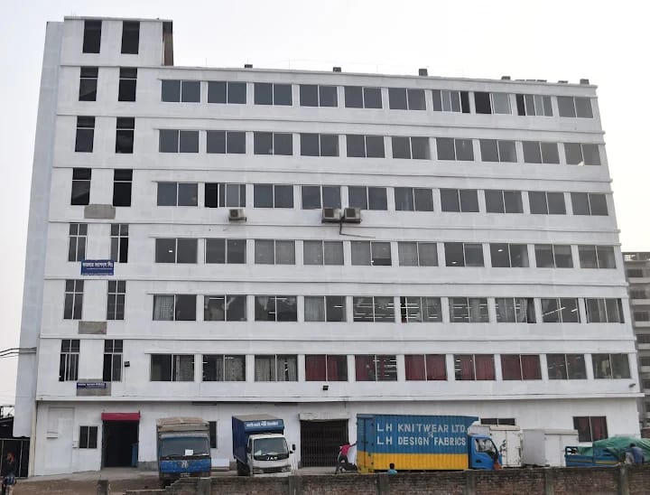
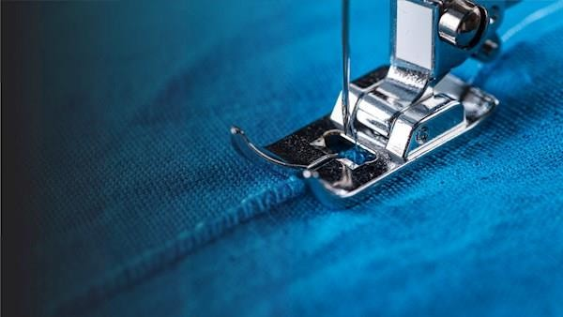
ABOUT US
Fardar Fashions Limited was established in 2020 by some entrepreneurs, then it was taken over by the present management body in 2020. The industry is a 100% export-oriented readymade Woven, Knit & Sweater garments industry located in Gazipur District (20 km north-east of Dhaka city). The sponsors have long been engaged in the manufacturing of ready-made garments.
The main objective of the proposed Ready Made Garments project is to ensure the supply of high-quality products to the export market from Bangladesh. The company aims to increase the competitive edge of Woven, Knit & Sweater apparels in export markets while achieving expected returns on investment.
Fardar Fashions Limited is dedicated to excellence in merchandising, product development, production, and logistics. The company has earned a reputation in the global apparel industry as one of the foremost factories in Bangladesh for its commitment to quality, timely delivery, and total value.
Through an extensive sourcing network, the company effectively procures the best materials. Customers rely on Fardar Fashions Limited to deliver high-quality products and superb service, enabling them to successfully compete in the emerging marketplace.
The company has a wide range of product development capabilities and utilizes progressive tools such as CAD-CAM to meet specific price points and achieve quality. The management team has a deep understanding of the needs of companies in the West and the production capabilities of firms in the East, making overseas sourcing easier.
www.fardarbd.com | info@fardarbd.com | Phone: +880 1865-018138

Slide 4









ABOUT US
Factory Address : Holding No. A 46/2, Mogorkhali, National University, Gazipur-1704
Legal Status : Private Limited Company
Year of Establishment : 2020
Type of Business : Woven, Knit & Sweater Garments Ind.
Factory Present Status : 100% Export Oriented
Contact Person : Zafar Iqbal (Chairman), zafar@ayexpress.com
Contact Person : Hilary Fernando (MD & CEO) hilary@fardarbd.com
Email: info@fardarbd.com
Website : https://fardarbd.com
Member of : BGMEA ID- 6540
Factory Space : Sweater: 50,000 Sqf, Knit & Woven: 1,25,000 Sqf
Total Employees : 1850 Person - Male %: 45 Female %: 65
Total Machines : Woven: 540 Set, Knit: 430 Set
Production Line : Woven: 10 Line, Knit: 10 Line
Production Capacity : Woven: 300,000 PCS, Knit: 350,000 PCS
Turnover : 20 Million (USD)
Market Coverage : Europe | America | Australia | Asia | Canada | Germany | France
Banking Status : Corporate Banking with United Commercial Bank Ltd
GSP Facility : Rex
Social Certificate : Amfori @ BSCI, SEDEX, OEKO TEX, GRS & RSC
FSCD Status : Certificate of License No: DD/DHAKA/29903/2020
www.fardarbd.com | info@fardarbd.com | Phone: +880 1865-018138

Slide 5
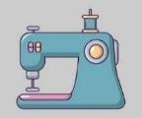





WHY PERTNER WITH US
M a n u f a c t u r i n g
L e a d T i m e
P r o c e s s & q u a l i t y
Our dedicated teams ensure high quality and
70-90 days from fabrics approval (Local Fabrics)
90-120 days from fabrics / print design or color selection (imported fabric by sea shipment).
A strict regime of internal audits, critical process check, 3rd party testing on fabric / accessories / garments and Pre-final Inspection @ AQL 2.5 are done prior to shipment.
craftsmanship standard remains consistent
whether order quantity is 1,500 or 100,000
pieces
MOQ
D e s i g n & D e v e l o p
H R & P o l i c y
Minimum order quantity is 2,000 pieces per color, per style. A large order
quantity allows higher efficiency at a reduced
manufacturing cost.
We can assist customer creating fits and design for garments. We offer choices of fabrication, wide range of accessories and different packaging method: flat pack, boxed pack, hanging garments, etc.
We follow a strict Code of Conduct (CoC) imbedded in our corporate HR policy – a
guideline to follow our company’s rules and
regulations and value every individual,
including our employees and customers.
www.fardarbd.com | info@fardarbd.com | Phone: +880 1865-018138

Slide 6



















OUR WORKING PROCEDURE
Knitting
Dyeing
Shipping
Cutting
Finishing
Print/Embroidery
Stitching
Washing
www.fardarbd.com | info@fardarbd.com | Phone: +880 1865-018138

Slide 7

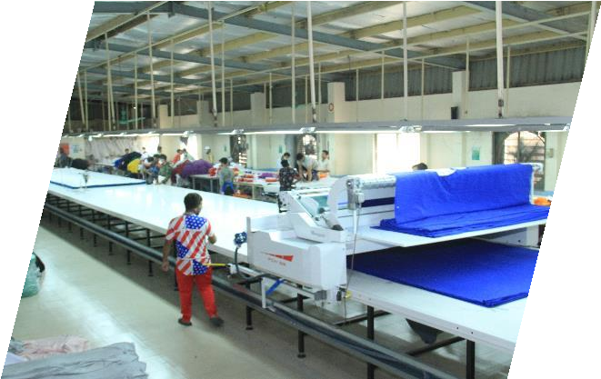
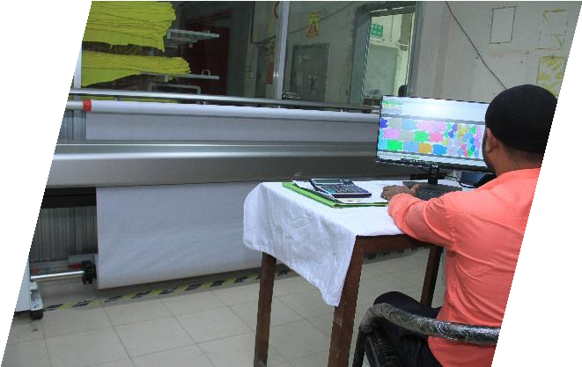
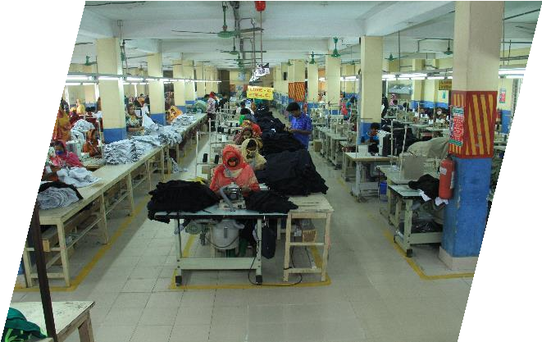
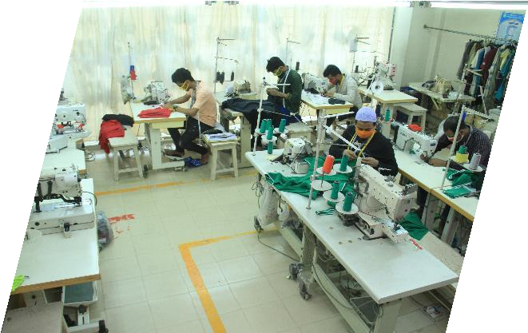
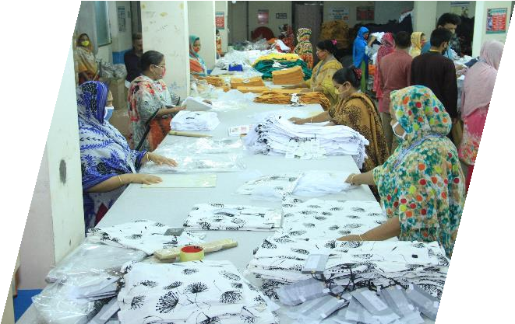
MANUFACTURING MATRIX
CAD
C U T T I N G
S T I T C H I N G
S A M P L E
F I N I S H I N G
www.fardarbd.com | info@fardarbd.com | Phone: +880 1865-018138

Slide 8
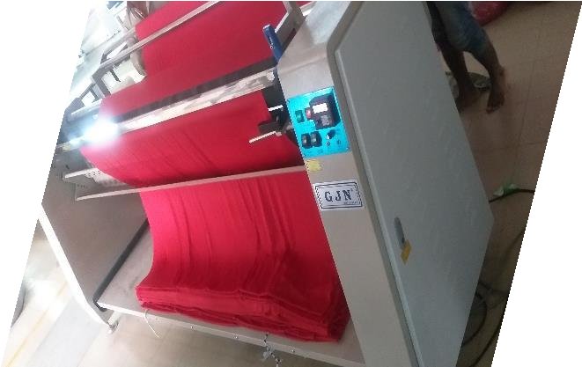
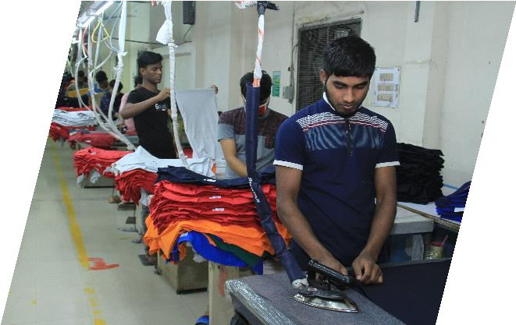
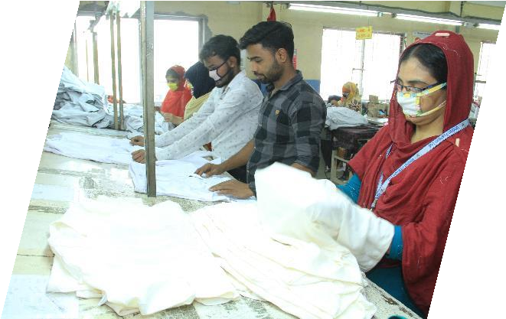
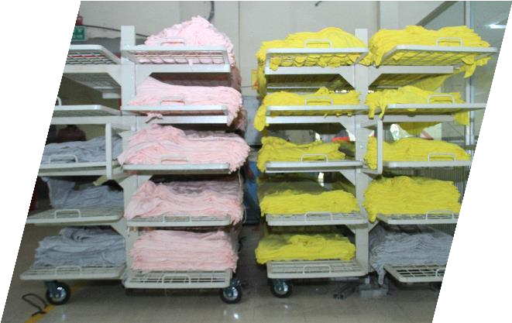
MANUFACTURING MATRIX
F A B R I C S R E L A X A T I O N
I R O N
Q U A L I T Y
F A B R I C S S T O C K
www.fardarbd.com | info@fardarbd.com | Phone: +880 1865-018138

Slide 9
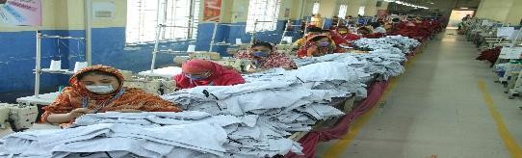



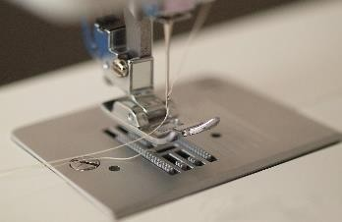
STATISICS
950+ Number of Employee
 | 95% On Time Delivery
0.5% Recheck / Rework
 | 600,000 Production Capacity / Month
800+ Number of Machine
www.fardarbd.com | info@fardarbd.com | Phone: +880 1865-018138

Slide 10






AWARDS & RECOGNITION
1.Business Social Compliance Initiative (BSCI)
2. Supplier Ethical Data Exchange (SEDEX)
3. International Labour Organization (ILO)
4. Organic Content Standard (OCS)
5. Organic Blended Standard (OBS)
6. Confidence In Textiles
www.fardarbd.com | info@fardarbd.com | Phone: +880 1865-018138

Slide 11








OUR VALUED PARTNER & EXPORT COUNTRIES
NETHERLAND
PORTUGAL
FRANCE
CARIBBEAN
UAE
ITALY
NEW ZELAND
AUSTRIA
www.fardarbd.com | info@fardarbd.com | Phone: +880 1865-018138

Slide 12











OUR VALUED PARTNER & EXPORT COUNTRIES
www.fardarbd.com | info@fardarbd.com | Phone: +880 1865-018138

Slide 13



OUR TECHNOLOGY & SYSTEM
Technology & Production:
Production Management headed by industrial engineering team.
Sophisticated technology, machinery & equipment acquired.
Production process technology acquired
Employment, training & human resource development schemes executed.
Technology & System:
All hardware / software – in place.
E-mail for communication with overseas & regional offices.
LAN Server Pentium III 500 MHz PC Server with 2x9.1 GB SCSI-3 HD, 256 MB RAM. New LAN Server Xeon 3.2 GHZ 1BM Series 226 with 4 X 73 GB. SCSI HDD DAT 72, 2GB RAM.
Digital Audiotape (DAT 8) – Data backup.
System Analyst, Programmers employed, Developing Systems and
Designing need based software.
Management Reports on Production, Marketing, Statutory & Management Accounts and MIS.
CCTV installed to cover all CT-PAT requirements.
Latest PA system installed to cover entire production set-up.
Auxiliary / Capital machinery:
Diesel Power Generator – 750 KVA, Royel, England.
Industrial JUT Fired Boiler, 1,000kg/hr, S M Boiler BD.
Industrial Air Compressor, 45 KW.
www.fardarbd.com | info@fardarbd.com | Phone: +880 1865-018138

Slide 14


OUR TECHNOLOGY & SYSTEM
Financial Systems & Controls:
Budget, Statutory & Management Accounts.
Periodical Internal & Annual External Audit.
Level of Authorities & Compliance.
Documentation, Recording & Controls with full dependence on Hardware & Software.
Shareholders & BOD confirmation through periodical meetings
Fulfilment of Standard Requirements:
FFL promises are not only for our products and quality; we also want to be known for taking responsibility for our business. This means:
FFL is trying to create a better environment, better social and working conditions in the country.
FFL business principles are sound, and we care about today’s and tomorrow’s environment.
Sample & Product Development Centre:
Professionally managed Run by fashion merchandising experts and equipped with modern machinery including CAD/CAM from Morgan Leonardo CAD System, Italy.
www.fardarbd.com | info@fardarbd.com | Phone: +880 1865-018138

Slide 15

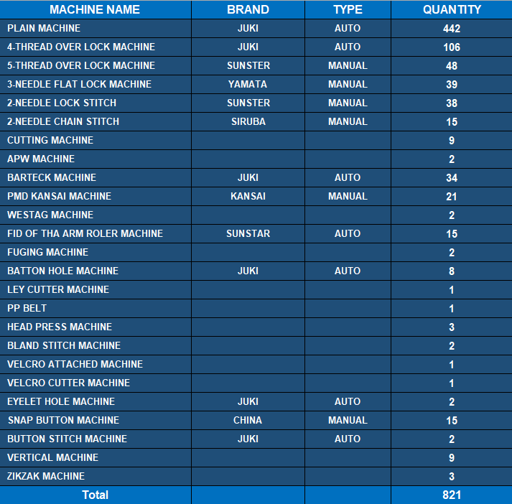
Sewing Machinery
Sewing requires passion, creativity, soul’s satisfaction and maneuvers from highly Advanced Cost-Effective Machines & Equipment like Energy Saving Bulbs, Servo-Motors & Thread Trimmers, etc. Our highly trained operators with great thirsts are continuously pouring out their sewing craftsmanship & artistry as the bobbin of our efforts never ends.
www.fardarbd.com | info@fardarbd.com | Phone: +880 1865-018138

Slide 16


Slide 17
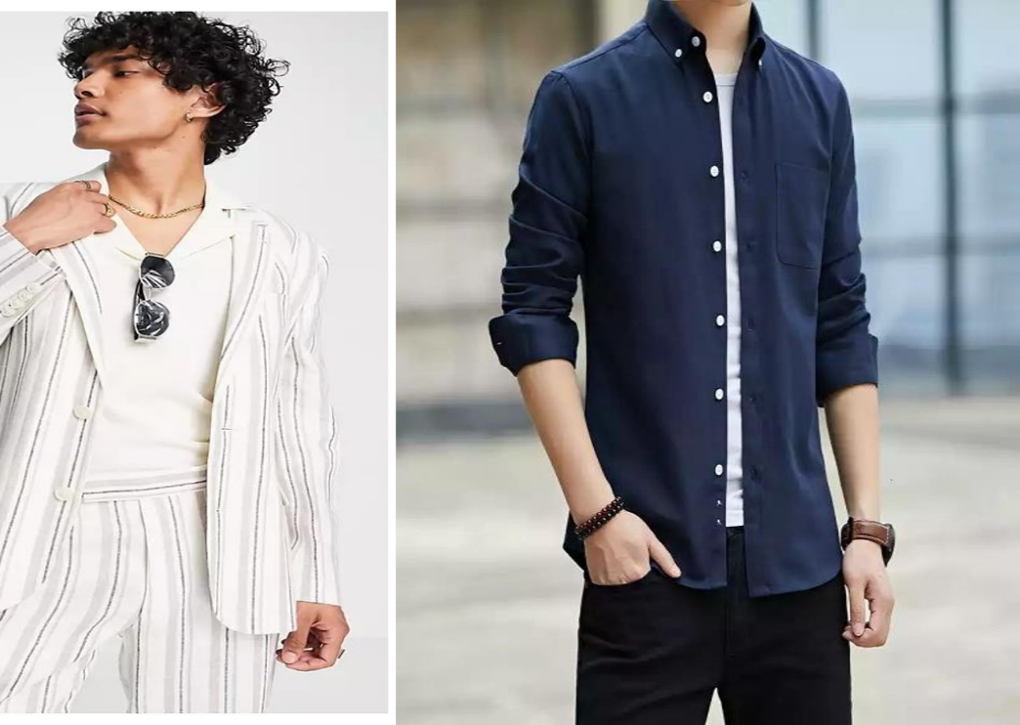
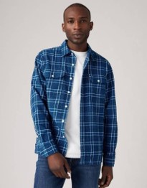
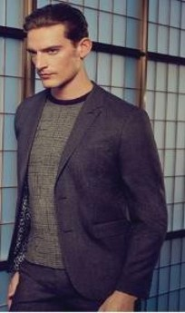
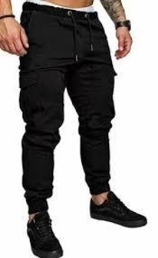
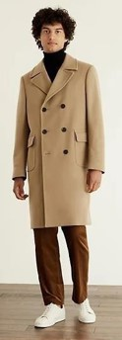
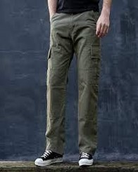

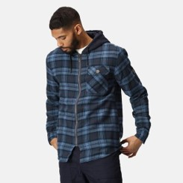
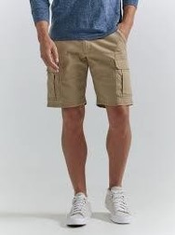
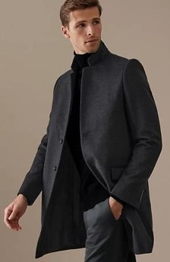
JACKET & SWEAT SHIRT
www.fardarbd.com | info@fardarbd.com | Phone: +880 1865-018138

Slide 18
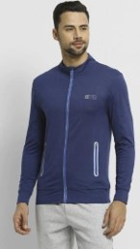
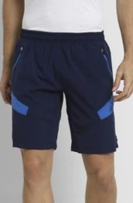
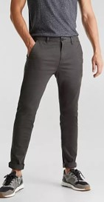
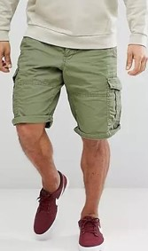
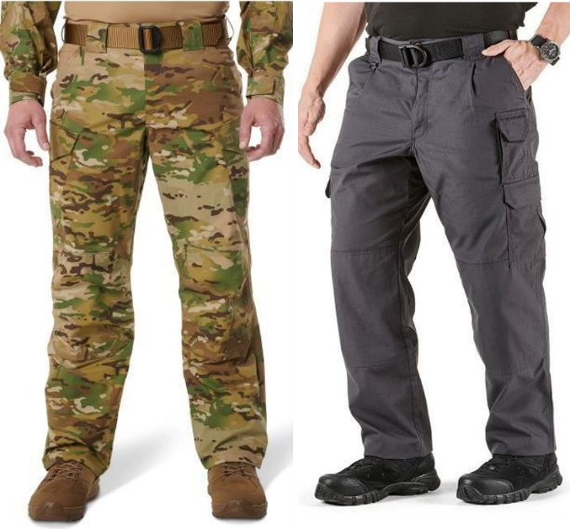
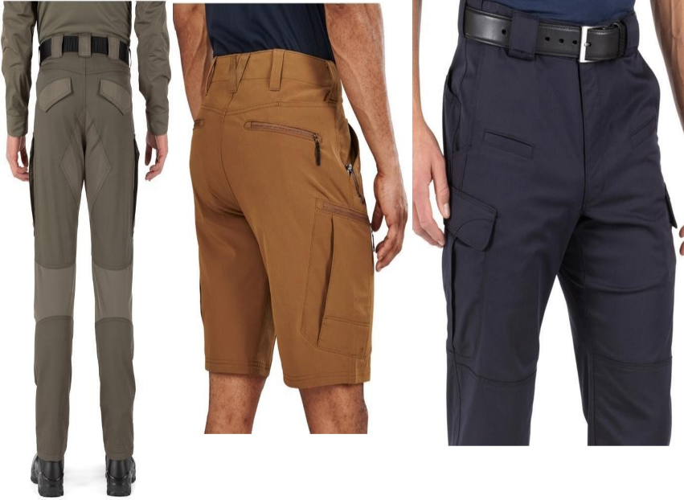
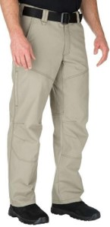
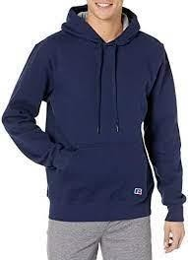
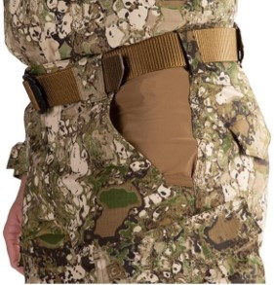
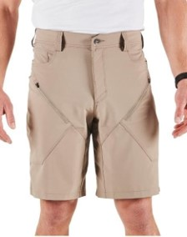
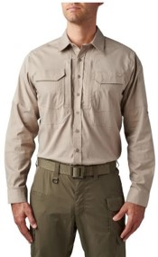
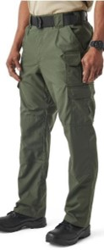
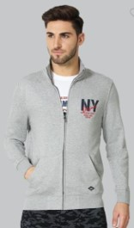
SHORTS & TROUSER
www.fardarbd.com | info@fardarbd.com | Phone: +880 1865-018138

Slide 19
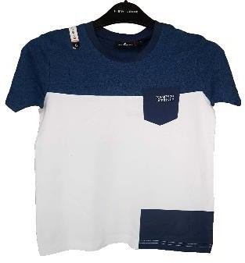
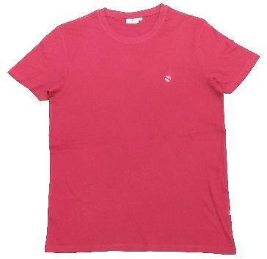
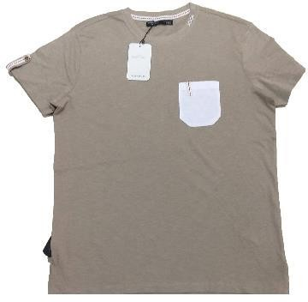
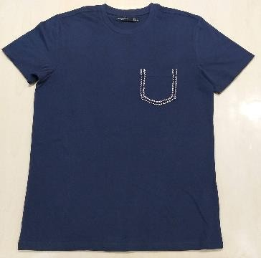
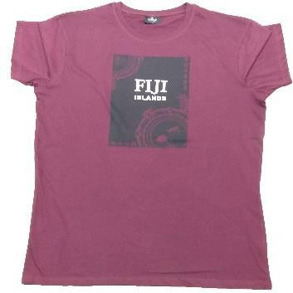
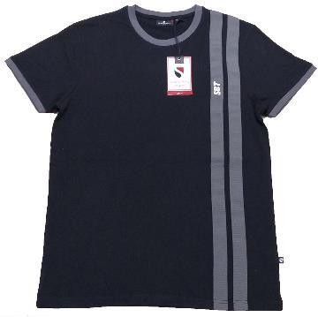
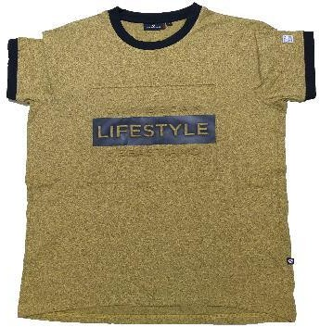
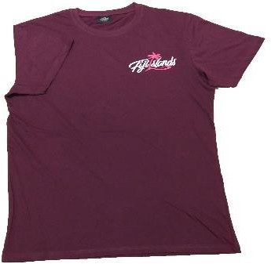
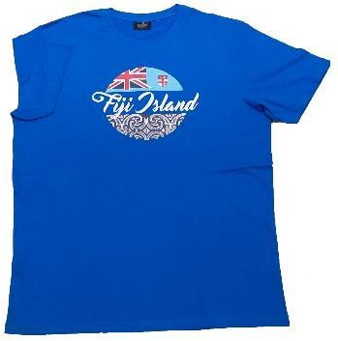
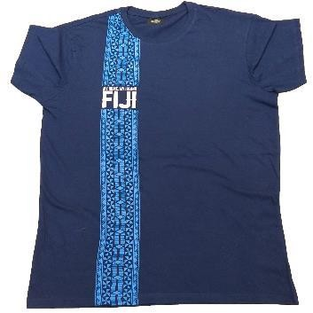
TEE-SHIRT
www.fardarbd.com | info@fardarbd.com | Phone: +880 1865-018138

Slide 20

TEE-SHIRT
www.fardarbd.com | info@fardarbd.com | Phone: +880 1865-018138

Slide 21


Slide 22








UNDER GARMENTS
www.fardarbd.com | info@fardarbd.com | Phone: +880 1865-018138

Slide 23


Slide 24










KIDS LONG TEE
www.fardarbd.com | info@fardarbd.com | Phone: +880 1865-018138

Slide 25










KIDS TEE-SHIRT
www.fardarbd.com | info@fardarbd.com | Phone: +880 1865-018138

Slide 26


Slide 27










LADIES DRESS
www.fardarbd.com | info@fardarbd.com | Phone: +880 1865-018138

Slide 28













LADIES DRESS
www.fardarbd.com | info@fardarbd.com | Phone: +880 1865-018138

Slide 29












LADIES DRESS
www.fardarbd.com | info@fardarbd.com | Phone: +880 1865-018138

Slide 30


Hilary Fernando MD & CEO
MD. Zafar Iqbal
Chairman
FFL group was founded in 2020, in Gazipur with the dream of serving to the apparel sector. More than 05 years of experience, our company has become a breath of fresh air and a driving force for the industry with both its innovative perspective and quality policies. Today, we export to more than 10 European countries as well as UAE, KSA, New Zealand, Australia. We are one of the reputed company within the sector now. The brands we work with are the company that always have high quality expectations and have a significant share in the sector. As the Chairman FFL group, I see our success target as quality at all times and also innovative perspective. I would like to express my thanks to everyone who kept sharing this passion with us.
The Chairman's vision—quality and innovation—is the foundation of the FFL Group.
Founded in Gazipur in 2020, our rapid growth is a direct result of our team's dedicated execution and focus on operational excellence. We reliably serve high-quality brands across Europe, the UAE, KSA, New Zealand, and Australia.
As CEO, my focus is future-forward: sustainable growth and setting new industry benchmarks. We will continue to invest in people and technology to ensure FFL remains a global leader.
Thank you to our entire team for transforming vision into reality.
www.fardarbd.com | info@fardarbd.com | Phone: +880 1865-018138

Slide 31



Thank You
Contact With us
Md. Zafar Iqbal
Chairman
Hilary Fernando
MD & CEO
Phone: +880 1865-018138
E-mail: info@fardarbd.com
web: www.fardarbd.com

